Slide 1
Using Machine Learning to Improve Legal Research
Capstone Presentation,
David N. Berol

Slide 2
The Business Task

Slide 3

The Business Task
An attorney at a law firm is tasked to “get up to speed” on some previously unfamiliar legal topic.
Assume a general familiarity with the overall branch of law.
But … need to know everything about a specific topic covered by >= 100 cases. Where to start reading?

Slide 4
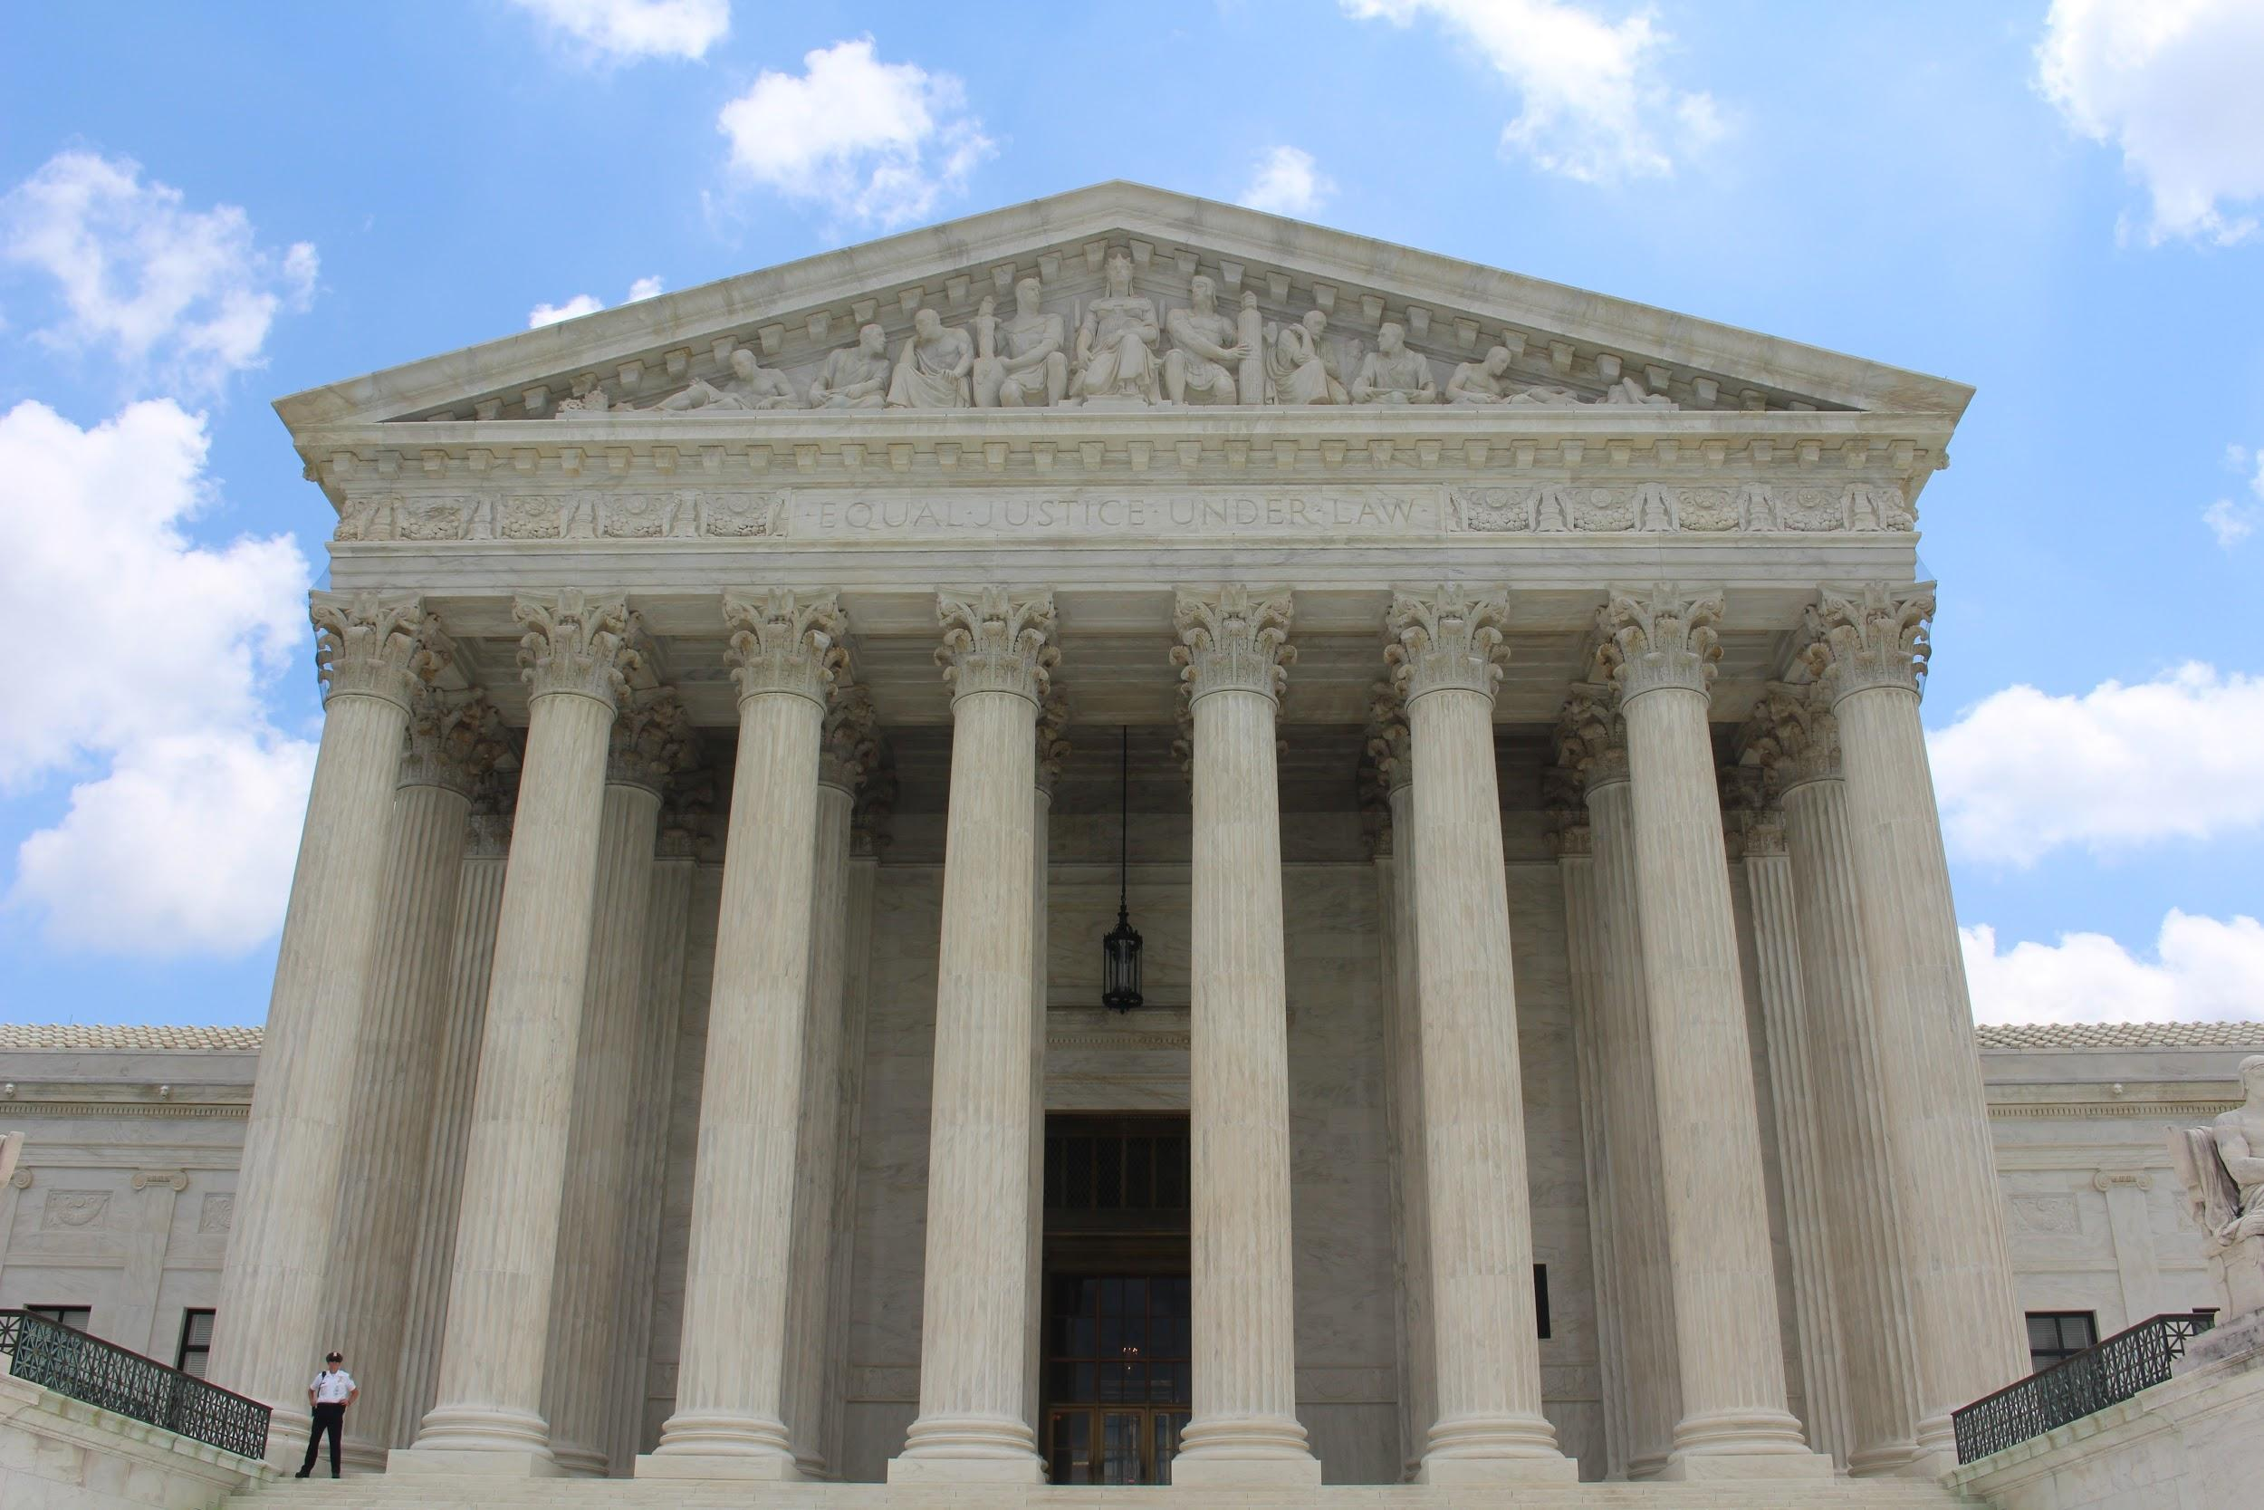
The Business Task
Let’s assume this is U.S. federal law.
Task is straightforward for the on-point U.S. Supreme Court precedent.
Read each and every case.
With luck, number of cases usually manageable.

Slide 5
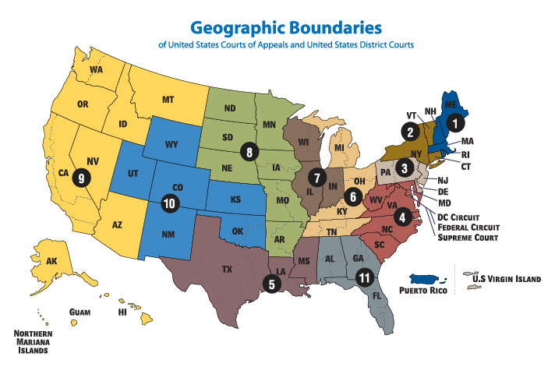
The Business Task
Harder question for Circuit Court (i.e., lower appellate courts) and District Court (i.e., trial courts) decisions.
# of cases in a particular jurisdiction easily >100
Where to start? Which sequences of cases represent important stories? (i.e., an important “line of cases”)

Slide 6
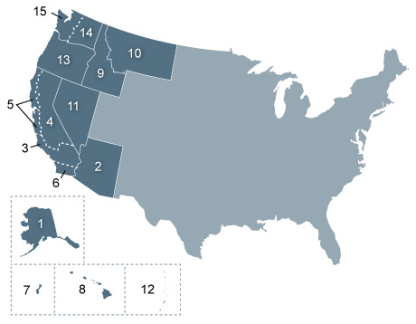
Sample Legal Topic for Case Study:
Section 7 Suits under the Endangered Species Act
Below SCOTUS level, topic dominated by a single jurisdiction (9th Circuit)
Topic easy to specify by keyword query (“ESA” & “endangered” & “Section 7”)
Topic has numerous opinions with analogous structure and repeating language elements.

Slide 7
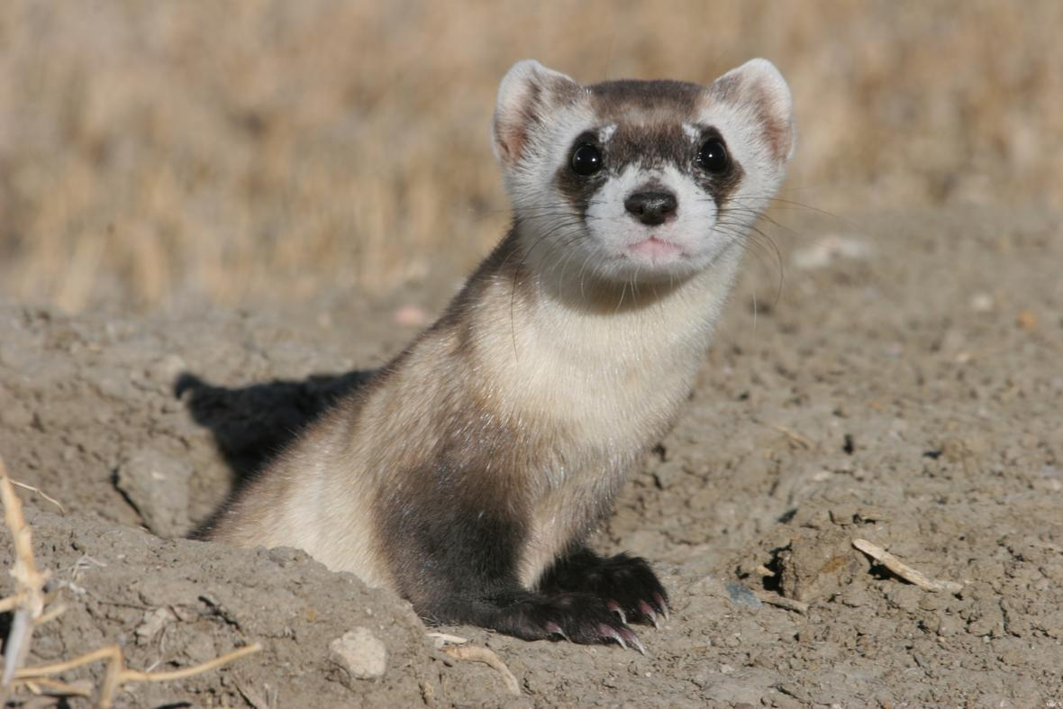
ESA Section 7 suits:
Objective is to throw a monkey wrench into some federal permitting process (e.g., timber sale, granting a pesticide license)
Dispute about whether federal agencies properly documented their consideration of endangered species (see, e.g., the black-footed ferret, left)

Slide 8
2. Data Source and Network Structure

Slide 9
2. Data Source and Network Structure
All court cases available via a RESTful API: <www. courtlistener.com>
Information available includes:
Full text of case
Official legal citation to case
Simple numeric ID for each case
List of all case ID #s cited by each case ID#
Citations can be represented as edges in a network.
Network analysis is one approach to identifying the “central cases” from a larger set.

Slide 10
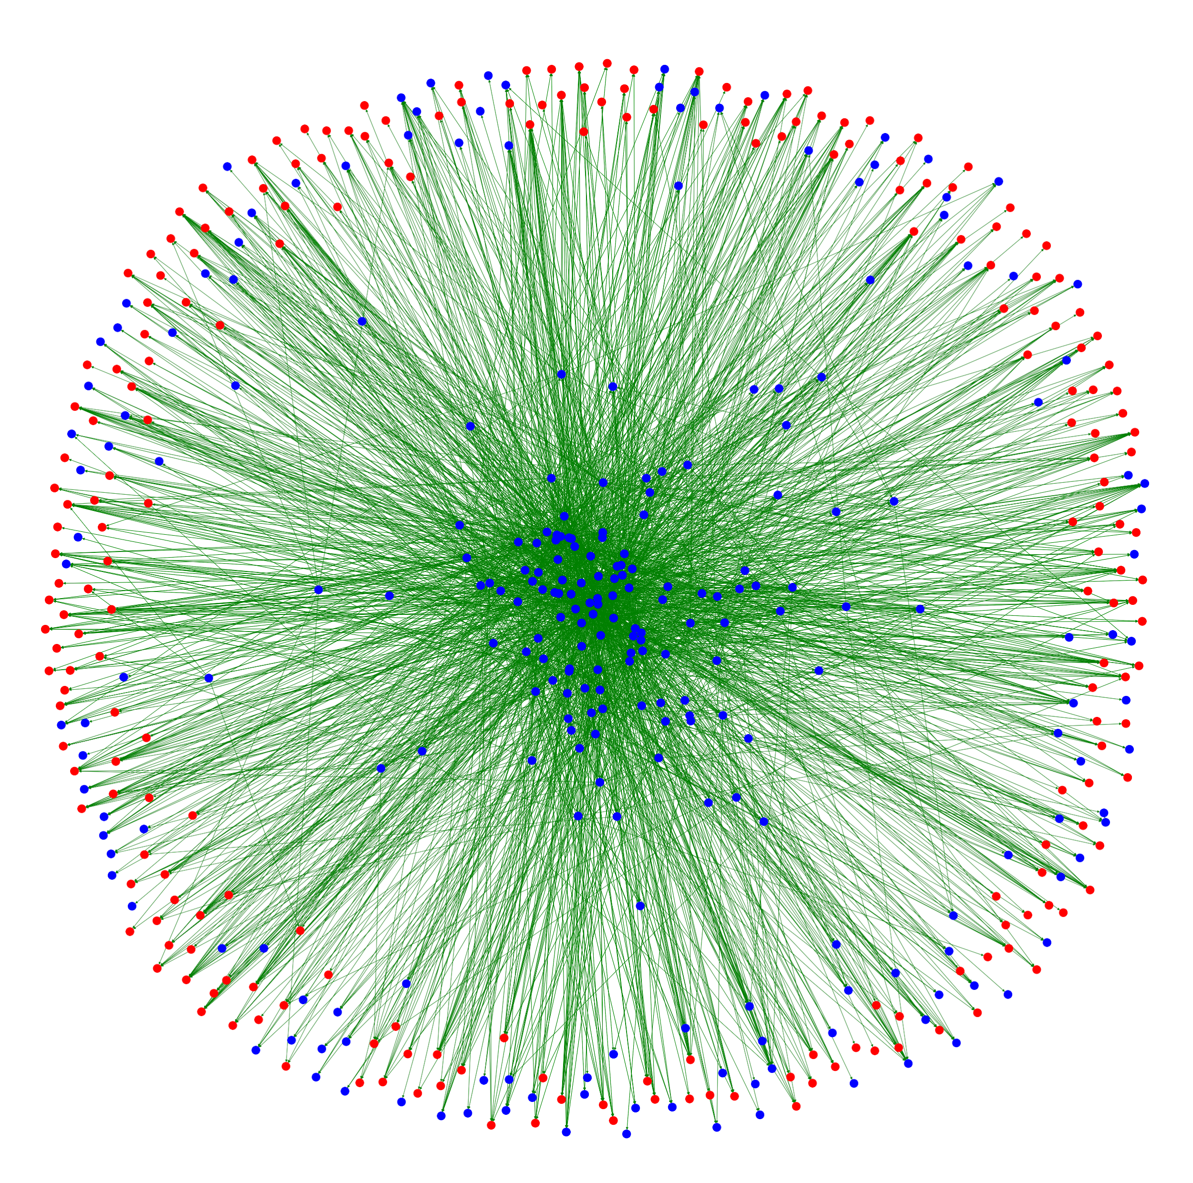
Network Graph
Blue dots are appeals courts cases
Red dots are the lower court cases
Green lines are citations between cases
Citations between lower court cases are omitted from the network, for simplicity
Newer appeals decisions aren’t yet cited, so they’re at the periphery.

Slide 11
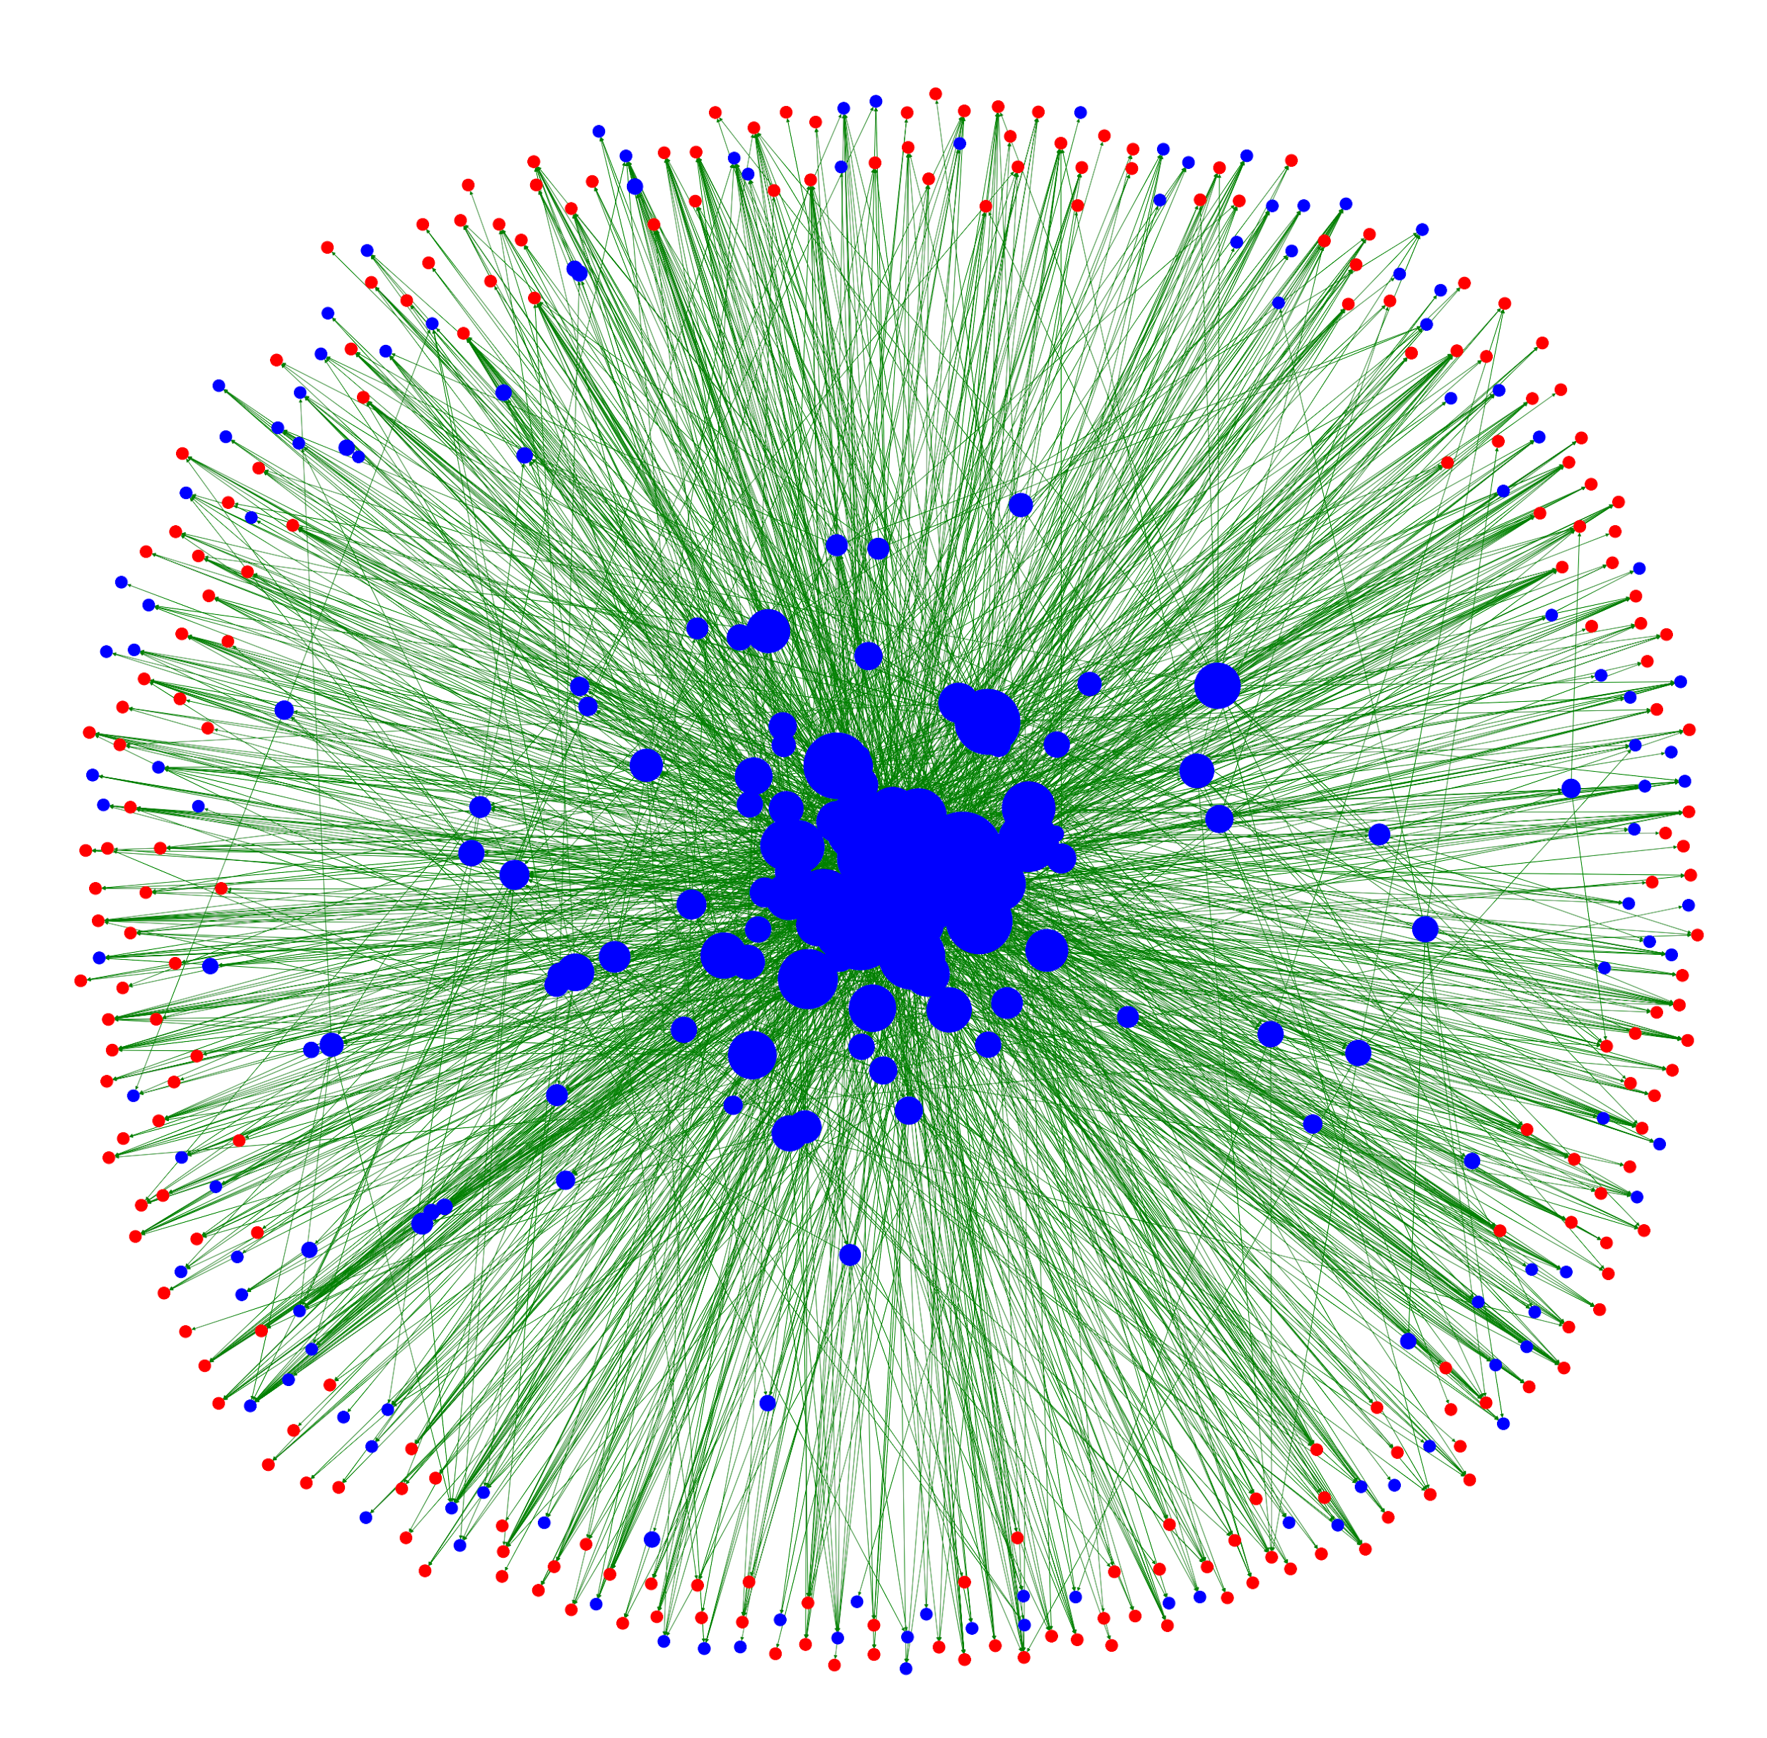
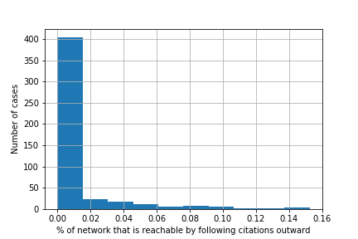
Network Graph
NetworkX: library for analyzing network structures.
Centrality: What % of the network can you reach downstream?
Cases sized by centrality.

Slide 12
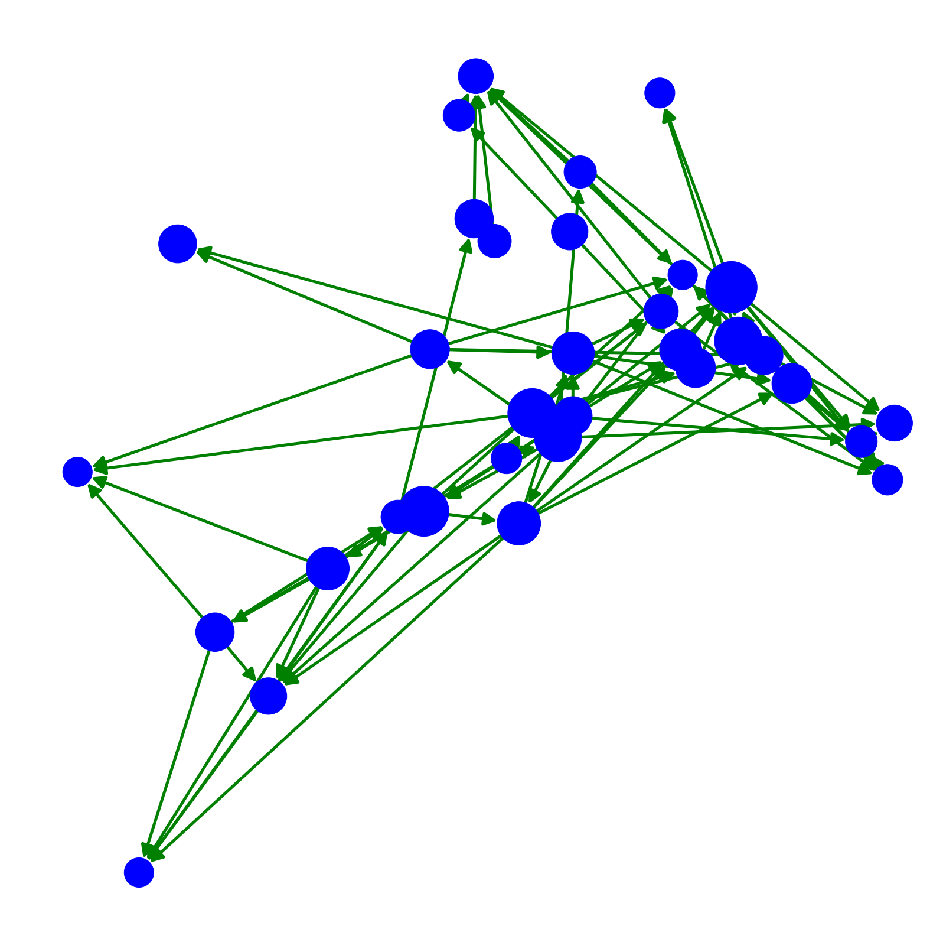
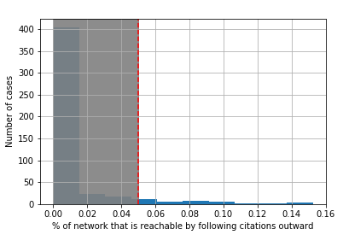
Network Graph
Limit network graph to centrality > 0.05
Links limited to subset

Slide 13
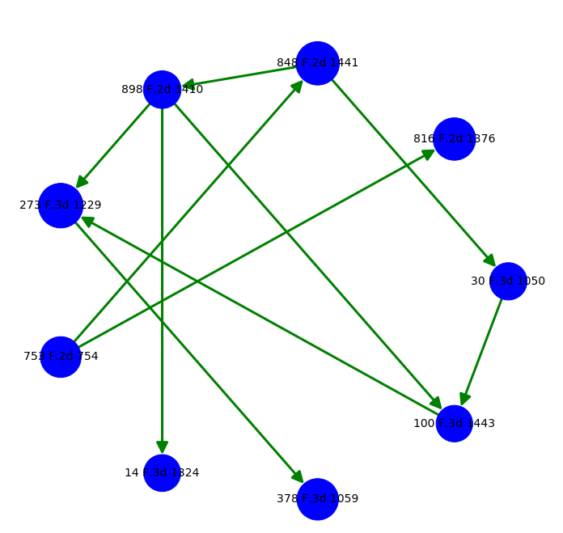
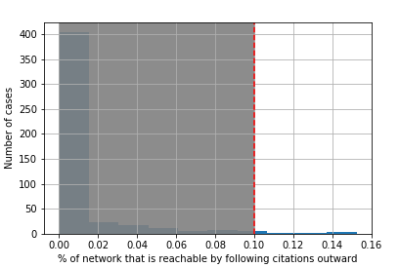
Network Graph
Limit network graph to centrality > 0.1
Links limited to subset

Slide 14
3. Citation-based Recommender System

Slide 15
3. Recommender System
Data on court cases is amenable to the construction of an item-based collaborative recommender system.
When a judge references an earlier court cases in a decision, that represents her judgment that the precedent of the earlier court case is somehow relevant to the topic at hand.
Didn’t have access to “sentiment” of citation. So all citations treated as equivalent.
Case X and Case Y are similar if subsequent decisions citing Case X also tend to cite Case Y.

Slide 16
3. Recommender System
Cited by Case ...
A B C D E F G H I J K L M N O P
Case X
1
0
0
0
1
0
0
1
1
0
0
0
0
0
0
0
Case Y
1
0
1
0
1
0
0
1
1
0
1
0
1
1
1
0
Dot product
1 + 0 + 0 + 0 + 1 + 0 + 0 + 1 + 1 + 0 + 0 + 0 + 0 + 0 + 0 + 0
= 4
Length of X vector
SQRT(1 + 0 + 0 + 0 + 1 + 0 + 0 + 1 + 1 + 0 + 0 + 0 + 0 + 0 + 0 + 0 )
= 2
Length of Y vector
SQRT(1 + 0 + 1 + 0 + 1 + 0 + 0 + 1 + 1 + 0 + 1 + 0 + 1 + 1 + 1 + 0 )
= 3
Cosine similarity of X and Y = (4/[2*3]) = .66
Cosine distance between X and Y = 1 - (4/[2*3]) = .33

Slide 17
3. Recommendation System
Looking for cases that are most cosine similar to Conner vs. Burford 848 F.2d 1441 (9th Cir. 1988) (Agency must re-do endangered species analysis because it was too narrow in scope)
Cosine similarity of 1 means parallel
Cosine similarity of 0
means perpendicular

Slide 18
3. Recommendation System
Cosine similarity of cases = 0.341
Conner vs. Burford 848 F.2d 1441 (9th Cir. 1988 (Agency must re-do endangered species analysis because it was too narrow in scope)
Sierra Club v. Marsh, 816 F.2d 1376 (9th Cir. 1987) (Agency must re-do endangered species analysis when circumstances of prior analysis change)

Slide 19
3. Recommendation System
Cosine similarity = .333
Conner vs. Burford 848 F.2d 1441 (9th Cir. 1988) (Agency must re-do endangered species analysis because it was too narrow in scope)
Pyramid Lake Tribe v. U.S Navy 898 F.2d 1410 (9th Cir. 1990) (Navy can rely on prior ESA analysis because plaintiffs didn’t point to any new facts not previously considered).

Slide 20
3. Recommendation System
Conner vs. Burford 848 F.2d 1441 (9th Cir. 1988) (Agency must re-do endangered species analysis because it was too narrow in scope)
Cosine similarity = .300
S.W. Center for Biological Diversity, 143 F.3d 515 (9th Cir. 1998) (ESA analysis still valid even though it was significantly revised between draft and final form)
Frequently cited alongside Conner v. Burford, but S.W. Center is not as central. So it doesn’t appear on this chart of most central cases.

Slide 21
4. Word2Vec Representation of Opinion Texts

Slide 22
4. Word2Vec Representation of Case Text
Word2Vec is an algorithm for representing vocabulary terms as vectors of arbitrary fixed dimension, which encode the contextual meaning of words.
Word2Vec is an alternative to simply “one-hot encoding” the vocabulary used in the appellate cases.
The word vector is composed of the weights, corresponding to that word, that a trained, shallow neural network uses to predict the context words surrounding any particular word in the corpus vocabulary.

Slide 23
4. Word2Vec Representation of Case Text
Represented each word used by the appellate courts as a 100-dimensional vector.
Used a very broad context window (40 words), so Word2Vec representation tells us more about the broad context in which a word is used than the specific meaning of that word.

Slide 24
model.most_similar('plaintiff')
[('defendant', 0.7680846452713013), ('injury', 0.746161937713623), ('establish', 0.7450809478759766), ('suffered', 0.7419219613075256), ('redressability', 0.7254083156585693), ('concrete', 0.725106418132782), ('asserting', 0.719348132610321),
model.most_similar('kill')
[('capture', 0.9633373618125916), ('wound', 0.9439411163330078), ('trap', 0.9321449995040894), ('harass', 0.9306020736694336), ('hunt', 0.9275879263877869), ('shoot', 0.9173321723937988), ('collect', 0.8839452862739563), ('porpoises', 0.87428218126297), ('migratory', 0.8684040904045105),
model.most_similar('salmon')
[('chinook', 0.8644458055496216), ('coho', 0.8242893218994141), ('steelhead', 0.8165823817253113), ('soncc', 0.7848293781280518), ('naturally', 0.7489623427391052), ('hatchery', 0.7464495301246643), ('spawning', 0.7408063411712646), ('snake', 0.7348811030387878),
Illustrations of how Word2Vec allows a contextual representation of the vocabulary used in court opinions:

Slide 25
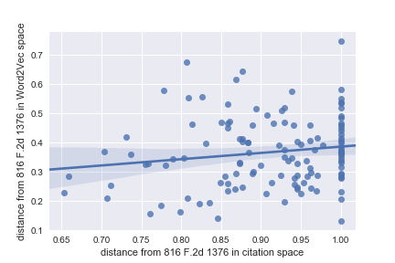
Cosine distances
We can compute cosine distances (1 - cosine similarity) between any two judicial opinions, given a system for “vectorizing” an opinion.
We now have two different systems for representing a case as a vector:
Citation relationships to other cases (one hot encode each other case that cites the pertinent case).
Contextual meaning of vocabulary in the case (average the Word2Vec vectors of all words in the case to make a case vector)
Any correlation between measurements under these systems?
Example: Plot the distances between 816 F.2d 1376 and all the other cases, using either Word2Vec or Citation Relationships as the basis for vectorizing each case. Correlation = .15
Caveat: Cosine distances do not actually constitute a true metric space. Cosine distances do not obey the triangle identity. Distance from A to C can be longer than distance from A to B + distance from B to C. See https://en.wikipedia.org/wiki/Cosine_similarity

Slide 26
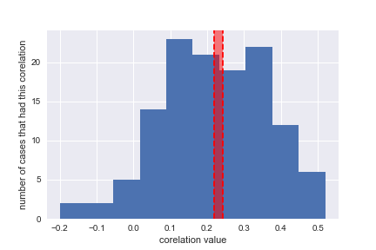
Cosine distances
What if we repeat the prior example for all possible distance pairs?
For all cases, what is the average correlation between inter-case distances calculated using citation relationships and inter-case distances calculated on the basis of Word2Vec?
We can compute cosine distances (1 - cosine similarity) between any two judicial opinions, given a system for “vectorizing” an opinion.
We now have two different systems for representing a case as a vector:
Citation relationships to other cases (one hot encode each other case that cites the pertinent case).
Contextual meaning of vocabulary in the case (average the Word2Vec vectors of all words in the case to make a case vector)
Any correlation between measurements under these systems?
From bootstrap analysis, 95% confidence interval for the average correlation between the two systems is between .214 and .246.

Slide 27
5. Doc2Vec Representation of Opinion Texts

Slide 28
5. Doc2Vec Representation of Case Text
Doc2Vec is an extension of the principle behind Word2Vec.
Represent each document as a vector. Lower dimensional than the classic “bag-of-words” representation (e.g., < 1000 dimensional vector, even though 1000 words are modeled in the corpus vocabulary)
The document vector records document-level parameters that a trained, shallow neural network uses (in addition to word vectors) to predict the context words surrounding any particular word in the vocabulary.

Slide 29
Vocabulary = [‘prince’, ‘castle’, ‘plaintiff’, ‘consultation’, ‘kiss’, ‘amphibian’, ‘frog’, ‘listed’, ‘witch’, ‘endangered’]
prince | 30%
castle | 5%
plaintiff | 2%
consultation | 5%
kiss | 25%
amphibian | 7%
frog | 5%
listed | 2%
witch | 15%
endangered | 4%
Documents = [‘fairy-tale’, ‘court opinion’]
“frog”
3-D word vectors and doc. vectors
“fairy-tale”
Fictitious sketch of how document vectors are generated from neural network training process. Document vector for a fairy-tale in orange. Word vector for a frog in mauve. Loss function would be based on probability of context words.

Slide 30
Cosine distances
We now have three different systems for representing a case as a vector:
Citation relationships to other cases (one hot encode each other case that cites the pertinent case).
Contextual meaning of vocabulary in the case (average the Word2Vec vectors of all words in the case to make a case vector)
Document context (the Doc2Vec vector)
Any correlation between inter-case distances measurements under 1st and 3rd system?

Slide 31
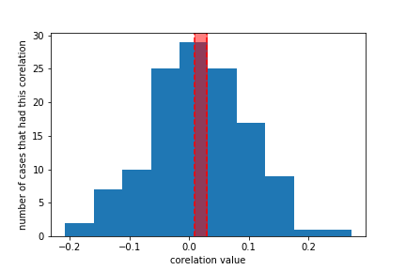
Cosine distances
Not really. 95% confidence interval for correlation is near zero.
We now have three different systems for representing a case as a vector:
Citation relationships to other cases (one hot encode each other case that cites the pertinent case).
Contextual meaning of vocabulary in the case (average the Word2Vec vectors of all words in the case to make a case vector)
Document context (the Doc2Vec vector)
Any correlation between inter-case distances measurements under 1st and 3rd system?
Does the document vector for an appellate opinion have any real-world meaning?

Slide 32
Classification Task
Distinguish between:
247 on-topic cases written in the 9th circuit.
205 on-topic cases written in other jurisdictions.
Delete header and footer rows from cases that may carry “give away” data
75%/25% train-test split
Fit Doc2Vec solely on basis of labeled training data.
40-dim. document vectors
Infer document vectors for both training and test sets, using fitted Doc2Vec model
Binary classification with Logistic Regression and SVC.

Slide 33
Classification Task
 | Training AUC-ROC | Test set AUC-ROC
Logistic Regression | 98.5% | 91.8%
SVC | 99.4% | 90.4%
Distinguish between:
247 on-topic cases written in the 9th circuit.
205 on-topic cases written in other jurisdictions.
Delete header and footer rows from cases that may carry “give away” data
75%/25% train-test split
Fit Doc2Vec solely on basis of labeled training data.
40-dim. document vectors
Infer document vectors for both training and test sets, using fitted Doc2Vec model
Binary classification with Logistic Regression and SVC.

Slide 34
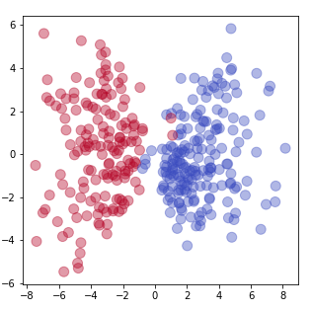
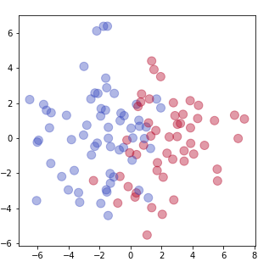
Classification Task
 | Training AUC-ROC | Test set AUC-ROC
Logistic Regression | 98.5% | 91.8%
SVC | 99.4% | 90.4%
Distinguish between:
247 on-topic cases written in the 9th circuit.
205 on-topic cases written in other jurisdictions.
Delete header and footer rows from cases that may carry “give away” data
75%/25% train-test split
Fit Doc2Vec solely on basis of labeled training data.
40-dim. document vectors
Infer document vectors for both training and test sets, using fitted Doc2Vec model
Binary classification with Logistic Regression and SVC.
2-D Projection of 40-D document vector:
Train Set Test Set

Slide 35
Take-aways
Network centrality is a useful technique to identify a core “line of cases” from a larger set
Can find similar cases using cosine similarity of network structure (i.e., item-based collaborative recommender)

Slide 36
Take-aways
Weak correlation between Word2Vec embeddings and citation structure
Essentially no correlation between Doc2Vec embeddings and citation structure

Slide 37
Take-aways
Some correlation between Word2Vec embeddings and citation structure
Essentially no correlation between Doc2Vec embeddings and citation structure

Slide 38
Take-aways
Training Set
Doc2Vec embeddings very useful for classification tasks involving legal opinions.
Holdout Set

Slide 39
Opportunities for further work ...
Further explore usefulness of Doc2Vec embeddings in other sorts of classification tasks (e.g., cases favoring a particular type of litigant? cases taking opposing views on a legal principle?)
This would require some laborious hand-labeling of court opinions
Further explore how network structure of a cluster of cases can be visualized to hone in on the most important cases
Classify/cluster cases based on how they are cited in legal briefs (i.e., not just published court opinions).

Slide 40

Questions?
Contact information:
David N. Berol
dnberol@gmail.com
https://dnberol.github.io/

